Slide 1
LEARNING MANAGEMENT SYSTEM
TS- WEB/CC/AI TRACK CAPSTONE PROJECT
Presented By:
Miss M.SaI Lakshmi – RGUKT Srikakulam
Miss Vanya Maddila – RGUKT Srikakulam
3. Miss Sk.Grace Jessy Moon – RGUKT Srikakulam
Miss Y.Nunandini –RGUKT Srikakulam
Miss R.Harika –RGUKT Srikakulam
Guided By: Mrs.Uma Maheswari Madam

Slide 2
OUTLINE
Abstract
Problem Statement (Should not include solution)
Aims , Objective & Proposed System/Solution
System Design
System Development Approach(Technology Used)
Conclusion
References
Future Scope

Slide 3
Abstract
The project is a Learning Management System (LMS) that focuses on providing high-quality , free of-cost content . many people are paying large sums of money for courses, even though similar content is available for free. The proposed solution is to gather and provide high- quality, free educational resources on a single website, including videos, documents, and other materials, in multiple languages (Telugu, English, and Hindi) in order to provide an effective and accessible method of learning for student.This system aims to improve upon existing LMS platforms by providing more comprehensive and diverse content, and by making it easily accessible to users.

Slide 4
Problem Statement
Many individuals are facing the challenge of having to pay high costs for educational resources, despite similar content being available for free. This creates barriers to access and affordability for many people, particularly those from disadvantaged backgrounds.

Slide 5
Proposed Solution
The proposed system aims to address the disadvantages of the existing system by providing high-quality educational content for free, in multiple languages on a centralized website that is easily accessible to all. The proposed system includes the following key features:
A centralized, user-friendly website that allows easy access to a wide range of educational content.
Educational documents and videos in multiple languages (Telugu, English, and Hindi) to support a diverse user base.
The ability for users to provide feedback and suggestions for improvement. A user-friendly interface that makes it easy for users to navigate and find the content they need.

Slide 6
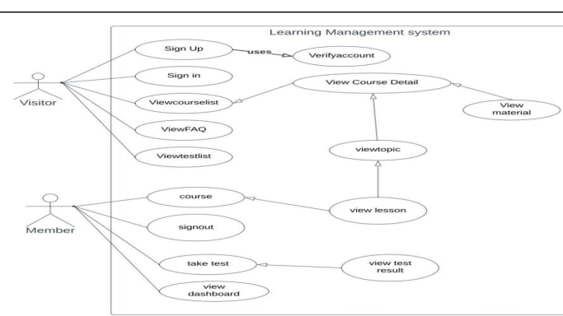
System Architecture

Slide 7
System Deployment Approach
Software Requirements
Hardware Requirements
HTML
CSS
Bootstrap
JavaScript
PHP
MySQL
RAM- 4GB above
Hard Disk -500GB above

Slide 8
Conclusion
In conclusion, the proposed project aims to address the issue of individuals spending large sums of money on courses despite the availability of quality content for free. By gathering and compiling this free content in one place, the project hopes to make it easily accessible to students and provide an effective method of learning. The website, documents, and instructional videos offered in Telugu, English, and Hindi will enhance the learning experience and help reduce financial burden on students. Overall, the project aims to provide accessible, quality education for all.

Slide 9
References
Online E Learning Platform
https://alison.com/
https://byjus.com/
https://www.sololearn.com/
https://ineuron.ai/
https://www.pirple.com/
https://www.vedantu.com

Slide 10
Future Scope
One of the best future enhancements for this project would be incorporating personalized learning. Personalized learning is an approach that tailors the learning experience to the individual student's needs and preferences. With this approach, the students will be able to learn at their own pace, focus on the areas they need to improve on and get more personalized feedback. This will help the students to retain information better and improve their overall understanding of the material. Personalized learning can be a powerful tool to make the education more effective, efficient and engaging for the students.

Slide 11
Git Hub Link
https://github.com/SAILAKSHMI-23/LMS

Slide 12
THANK YOU

